Slide 1
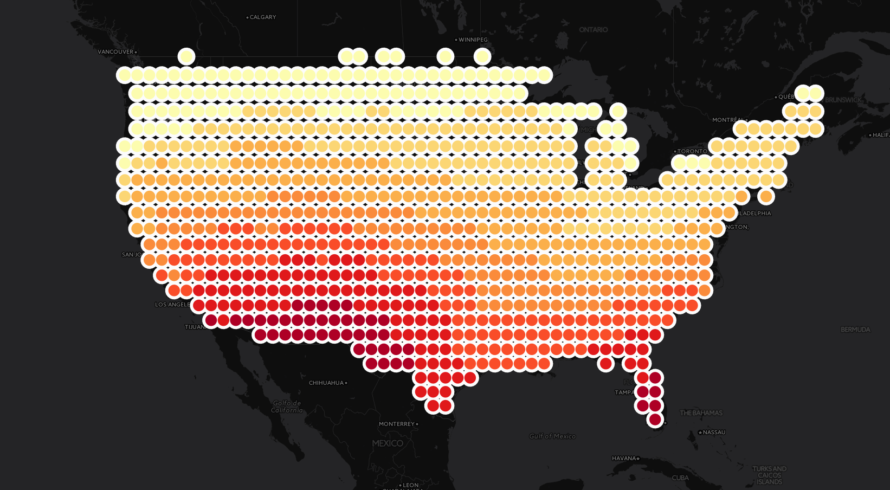
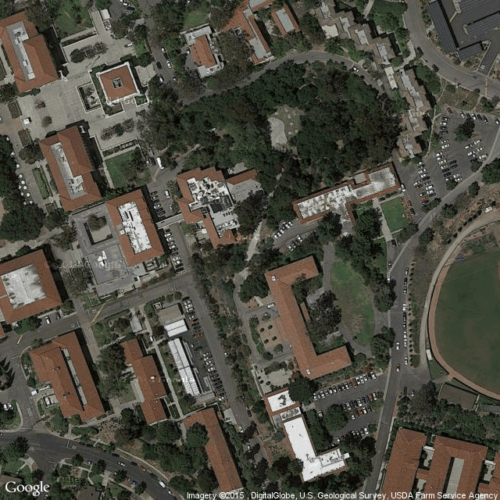
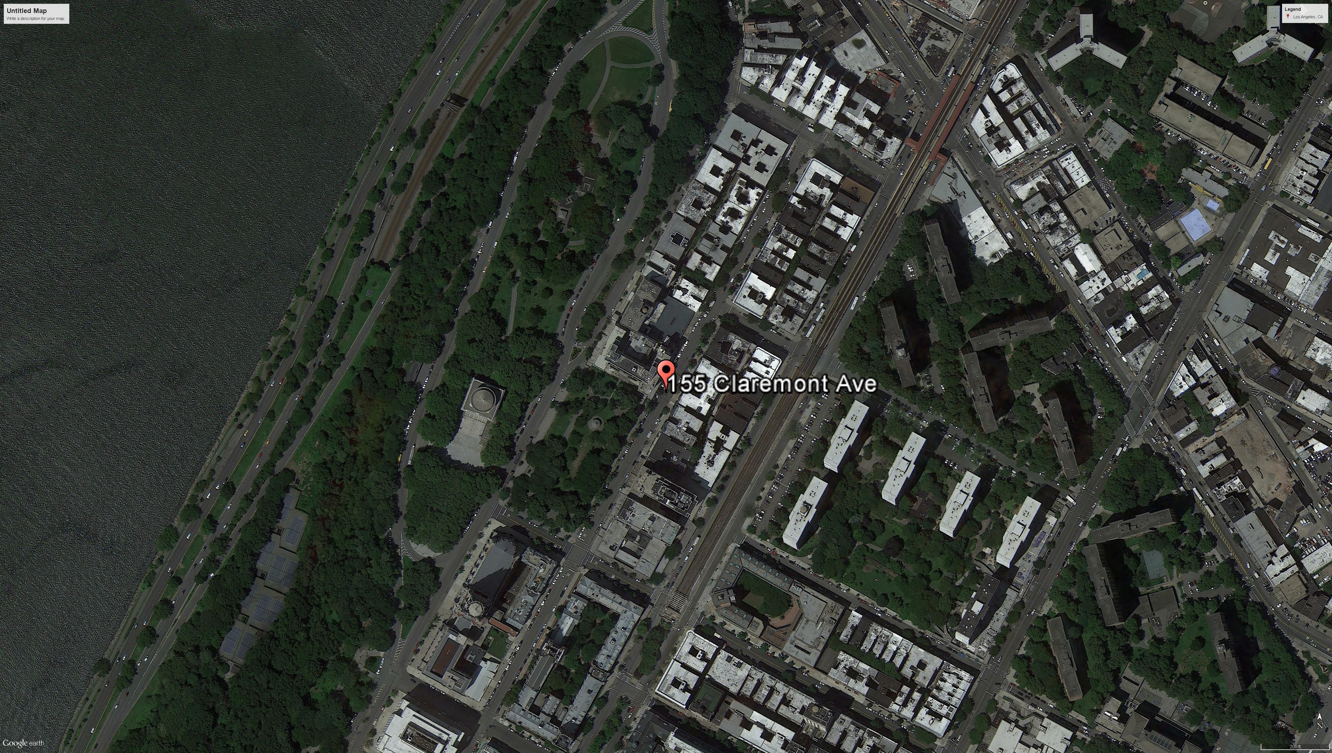
Solar Score Map
Los Angeles
Price : $16/unit
Insolation: 3.6 KWh/m²/day
Area: 290 m²
New York City
Price : $18/unit
Insolation : 2.6 KWh/m²/day
Area : 234 m²

